Slide 1
UNIT-I
Solar Energy Fundamentals

Slide 2
Energy
Energy can be classified into several types based on the following criteria:
Primary and Secondary energy
Commercial and Non-commercial energy
Renewable and Non-Renewable energy
Conventional and Non-conventional energy

Slide 3
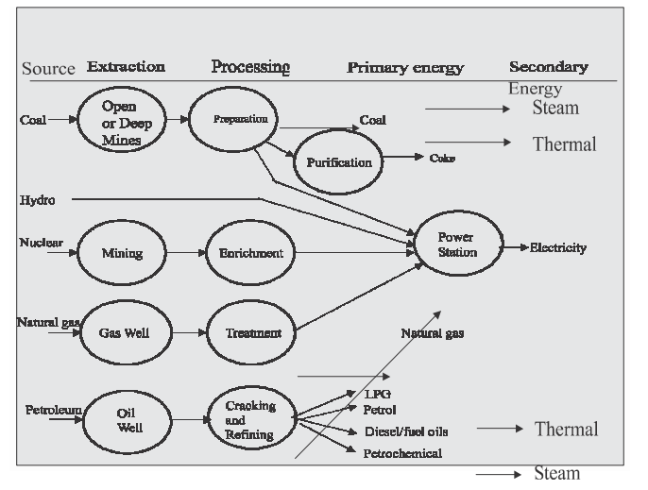
Primary and Secondary Energy
Primary energy sources are those that are either found or stored in nature. Common primary energy sources are coal, oil, natural gas, and biomass (such as wood). Other primary energy sources available include nuclear energy from radioactive substances, thermal energy stored in earth's interior, and potential energy due to earth's gravity.

Slide 4
Commercial Energy and Non Commercial Energy
Commercial Energy
The energy sources that are available in the market for a definite price are known as commercial energy. By far the most important forms of commercial energy are electricity, coal and refined petroleum products.
Commercial energy forms the basis of industrial, agricultural, transport and commercial development in the modern world. In the industrialized countries, commercialized fuels are predominant source not only for economic production, but also for many household tasks of general population. Examples: Electricity, coal, oil, natural gas etc
Non-Commercial Energy
The energy sources that are not available in the commercial market for a price are classified as non-commercial energy. Non-commercial energy sources include fuels such as firewood, cattle dung and agricultural wastes, which are traditionally gathered, and not bought at a price used especially in rural households. These are also called traditional fuels. Non-commercial energy is often ignored in energy accounting.

Slide 5
Renewable and Non-Renewable Energy
Renewable energy is energy obtained from sources that are essentially inexhaustible. Examples of renewable resources include wind power, solar power, geothermal energy, tidal power and hydroelectric power. The most important feature of renewable energy is that it can be harnessed without the release of harmful pollutants.
Non-renewable energy is the conventional fossil fuels such as coal, oil and gas, which are likely to deplete with time.

Slide 6
Conventional and Non-conventional energy resources
Conventional Energy
Conventional energy resources which are being traditionally used for many decades and were in common use around oil crisis of 1973 are called conventional energy resources, e.g., fossil fuel, nuclear and hydro resources.
Non-conventional energy
Non-conventional energy resources which are considered for large scale use after oil crisis of 1973, are called non-conventional energy sources, e.g., solar, wind, biomass, etc.

Slide 7
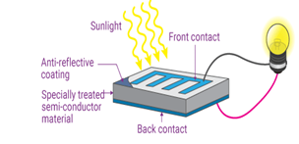
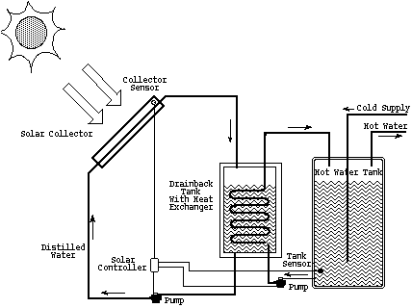
Various forms of Renewable Energy
Renewable energy. ‘Energy obtained from natural and persistent flows of energy occurring in the immediate environment’. An obvious example is solar (sunshine) energy
Solar Energy
Electricity can be generated from solar energy in two ways:
Photovoltaic Electricity - generates electricity by absorbing direct sunlight through photovoltaic cells.
Solar-Thermal Electricity - A solar collector with a mirrored surface reflects sunlight onto a receiver, which heats a liquid. This heated liquid is used to produce steam, which generates electricity.

Slide 8
Wind Energy
Wind energy is the kinetic energy associated with atmospheric air movement.
Wind turbines convert wind energy into mechanical power, which is then converted to electric power to generate electricity. Wind creates lift on the blades, which causes the blades to turn (similar to the effect on airplane wings).The blades are attached to a drive shaft that rotates an electric generator, which generates electricity.
Due to its strength and efficiency, horizontal axis wind turbines are the most often utilized turbines.

Slide 9
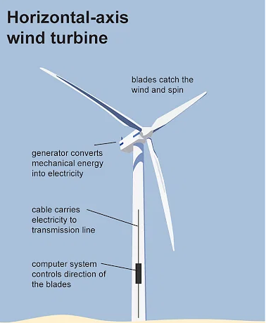

Slide 10
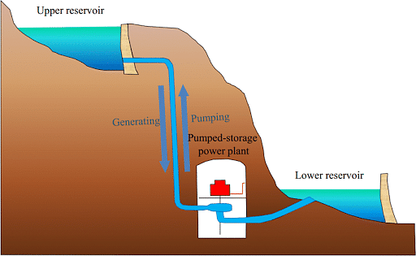
Hydro Power
Hydropower is the use of water's natural force to generate electricity (kinetic energy).
Hydroelectric systems capture the energy and convert it to power using a turbine and generator.
Because the sun replenishes the water supply, hydropower is regarded as a renewable energy source. This implies that it is a limitless resource.
It's also environmentally friendly because it doesn't produce greenhouse gases, which contribute significantly to pollution and global warming.
Today, China is the world's greatest hydropower generator, followed by Canada, Brazil, and the United States.
Hydropower is expected to be the world's dominating energy resource for many years to come due to its abundance.

Slide 11
Ocean Thermal Energy
Large amounts of solar energy are stored in the oceans and seas. The tropical seas absorb solar radiation equivalent to the heat content of 245 billion barrels of oil on average.
The process of harnessing this energy is known as OTEC (ocean thermal energy conversion).
It uses temperature differences between the ocean's surface and depths of about 1000 metres to power a heat engine, which generates electricity.
Ocean Thermal Energy Conversion (OTEC) is a marine renewable energy system that generates electricity by harnessing the solar energy collected by the oceans.
The sun's heat warms the surface water much more than the deep ocean water, creating a natural temperature gradient, or thermal energy, in the ocean.
OTEC vaporizes a working fluid with a low boiling point, such as ammonia, using the ocean's warm surface water with a temperature of around 25°C (77°F).

Slide 12
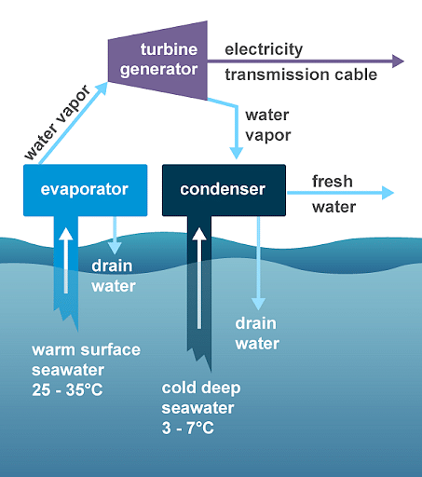
To generate energy, the vapor expands and turns a turbine connected to a generator.
Seawater pushed from the deeper ocean layer, where the temperature is around 5°C (41°F), subsequently cools the vapor.
The working fluid is then condensed back into a liquid, ready to be reused. This is a continuous cycle for generating power.
The temperature differential has a significant impact on the cycle's efficiency.
The higher the temperature difference, the more efficient the system is.
As a result, the technology is only viable in tropical regions with a year-round temperature difference of at least 20 degrees Celsius (36 degrees Fahrenheit).

Slide 13

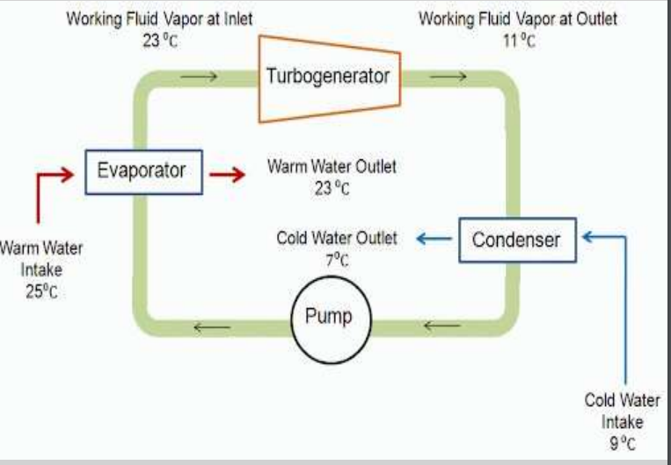

Slide 14
Closed-cycle OTEC plant uses low boiling point working fluid to rotate a turbine to generate electricity.
• Warm surface seawater is pumped through a heat exchanger (evaporator) to vaporize the fluid.
• The vapor expands at moderate pressures and turns the turbine coupled with a generator that produces electricity.
• The exhaust vapor is then condensed in another heat exchanger (condenser) using cold deep seawater.
• The condensed working fluid is recycled to the evaporator to repeat the process.
• The working fluid remains in a closed cycle and circulates continuously.
• The principal components are the heat exchangers, turbo generator, and seawater supply system, which accounts for most of the parasitic power consumption and a significant fraction of the capital expense.
• Closed-cycle OTEC power systems, which operate at elevated pressures, require smaller turbines than open-cycle systems

Slide 15
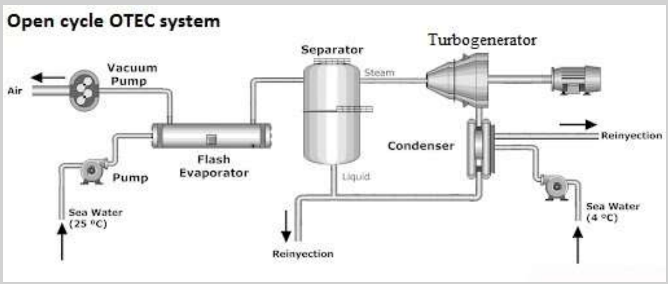

Slide 16
The open-cycle OTEC plant uses warm surface water as the working fluid to make electricity.
• The warm seawater is flash evaporated in a vacuum chamber to produce steam at an absolute pressure of about 2.4 kPa.
• The steam expands through a low-pressure turbine coupled with a generator that produces electricity.
• The exhaust steam is condensed back into liquid by cold deep seawater pumped from the depth through a cold-water pipe.
• If a surface condenser is used in the system, the condensed steam remains separated from the cold seawater and provides desalinated fresh water suitable for drinking or irrigation.
• The evaporator, turbine, and condenser operate in partial vacuum ranging from 3% to 1% atmospheric pressure. This poses a number of practical concerns that must be addressed.

Slide 17
Biomass
Biological material, such as that found in plants and animals, is what is referred to as organic material, or biomass.
Plants, wood, and waste are the most common biomass materials used for energy. They are referred to as biomass feedstocks.
A non-renewable energy source that uses biomass is also possible.
The energy in biomass is initially obtained from the sun: through photosynthesis, plants transform carbon dioxide and water into nutrients (carbohydrates).
Both direct and indirect methods can be used to convert the energy from these creatures into useable energy.
Direct combustion of biomass can provide heat, direct conversion of biomass to electricity, or direct conversion of biomass to biofuel (indirect).

Slide 18
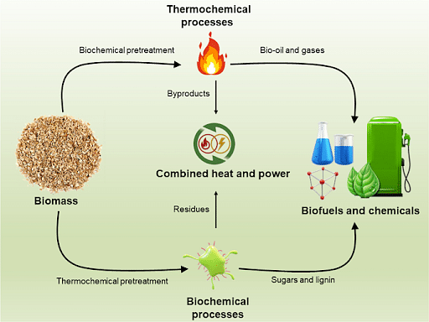
Biomass - Products
Biofuel
Only biomass can be transformed into liquid biofuels like ethanol and biodiesel, making it the only renewable energy source that can do so.
High-carbohydrate biomass, such as sugar cane, wheat, or corn, is fermented to produce ethanol.
Ethanol with vegetable, recycled, or animal fat are combined to create biodiesel.
Gasoline is more efficient than biofuels in operation. They do not produce the emissions associated with fossil fuels, but they can be combined with gasoline to effectively power automobiles and machinery.

Slide 19
Geothermal Energy
Geothermal energy is natural heat derived from the earth's interior that can be used to generate electricity and heat structures.
A layer of hot, molten rock called magma exists beneath the earth's crust.
The decay of naturally radioactive materials like uranium and potassium produces heat in this layer on a continuous basis.
Heat within 10,000 meters (33,000 feet) of the earth's surface contains 50,000 times more energy than all of the world's oil and natural gas reserves combined.
There are three types of geothermal resources: geopressurized zones, hot-rock zones and hydrothermal convection zones.
Only the first of these three is currently being commercially exploited.
Hot Springs, Geysers and Lava Fountain are some natural examples of geothermal energy.
According to the Ministry of New and Renewable Energy, geothermal resources in India have been mapped, and as per general estimates there could be a 10 gigawatt (GW) geothermal power potential.

Slide 20
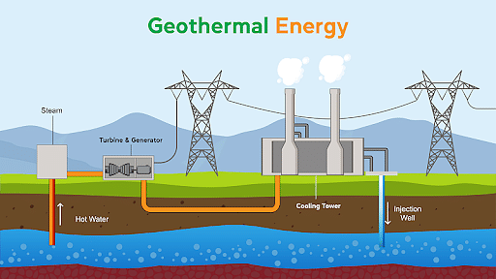

Slide 21
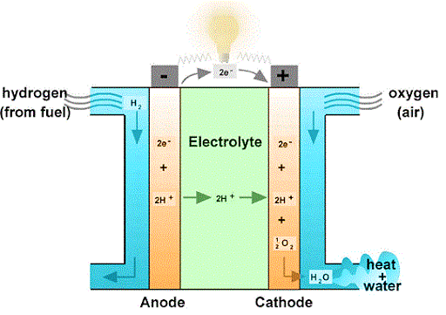
Fuel Cells
A fuel cell is a device that uses a chemical reaction to generate electricity.
A positively charged ion (Hydrogen) and an oxidizing agent (oxygen) are used in fuel cells.
Fuel cells come in a variety of shapes and sizes, but they all have a cathode, an anode, and an electrolyte that permits positively charged (hydrogen) ions to travel between the two sides.
Fuel cells differ from batteries in that they require a constant source of fuel.
Direct current (D.C) is produced by both batteries and fuel cells.

Slide 22
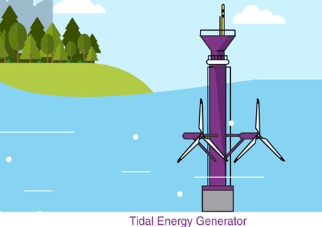
Tidal Energy
Tides are a regular phenomenon. They can be predicted over months and years in advance. This is why the energy from this massive movement of water can be harnessed and converted into a usable form of energy.
The energy obtained from the rise and fall of tides is called tidal energy.
Tidal barrages or dams are constructed across a narrow opening to the sea. Water rushes into the dam when the sea level rises. This moves the blades of the turbines which are attached at the opening of the dam. This results in the generation of electricity.
India is expected to have 9,000 MW of tidal energy potential.

Slide 23
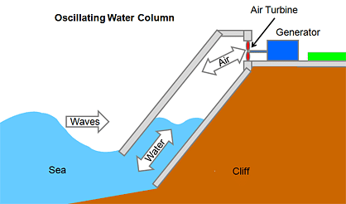
Wave Energy
A wave energy converter (WEC), which is essentially a power station, converts wave energy hitting the coast into electricity.
It's a sealed chamber with a hole in the bottom that allows strong sea waves to flow into and out of it.
The water level in the chamber rises and falls in time with the wave, forcing air forward and back through turbines connected to an upper aperture in the chamber.
The turbines can be powered by compressed and decompressed air.
The back and forth airflow through the turbine propels the turbine in the same direction.
A shaft attached to a generator is turned by the propelling turbine.
The generator generates power, which is then delivered to electrical grids and then to demand centers and distribution lines that connect individual homes and businesses.
The advantage of this wave energy converter is that even very small wave motions can generate enough airflow to keep the turbine spinning and generate energy.

Slide 24
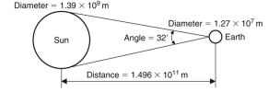
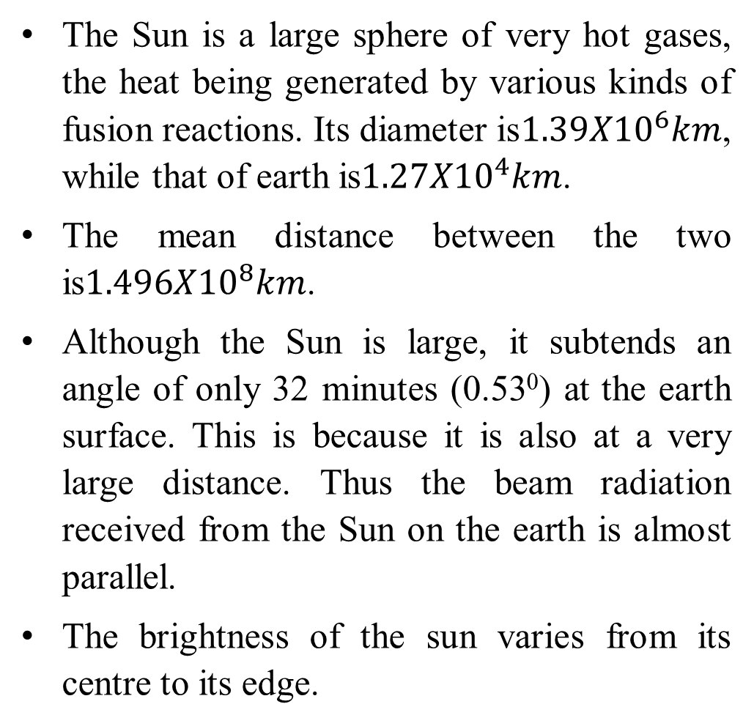
Solar Radiation: Outside Earth’s atmosphere
The Sun is a large sphere of very hot gases, the heat being generated by various kinds of fusion reactions. Its diameter is$1.39X{10}^{6}km$, while that of earth is$1.27X{10}^{4}km$.
The mean distance between the two is$1.496X{10}^{8}km$.
Although the Sun is large, it subtends an angle of only 32 minutes (0.53⁰) at the earth surface. This is because it is also at a very large distance. Thus the beam radiation received from the Sun on the earth is almost parallel.
The brightness of the sun varies from its centre to its edge.

Slide 25
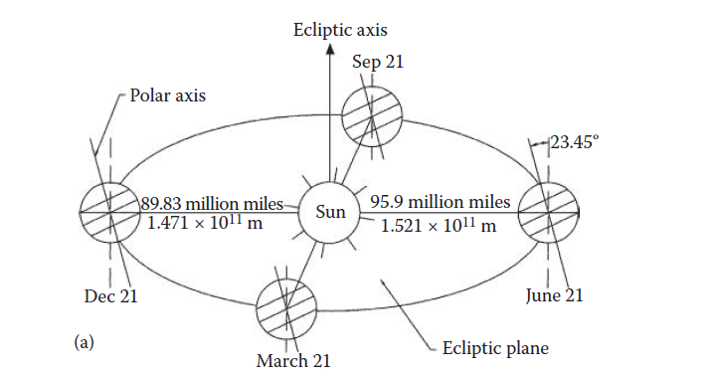
FIGURE : Motion of the earth about the sun.
Figure shows the annual orbit of the earth around the sun.
The distance between the earth and the sun changes throughout the year.
The minimum being 1.471 × 1011 m at winter solstice (December 21) and the maximum being 1.521 × 1011 m at summer solstice (June 21).
The year-round average earth– sun distance is 1.496 × 1011 m. The amount of solar radiation intercepted
by the earth, therefore, varies throughout the year, the maximum being on December 21 and the minimum on June 21.

Slide 26
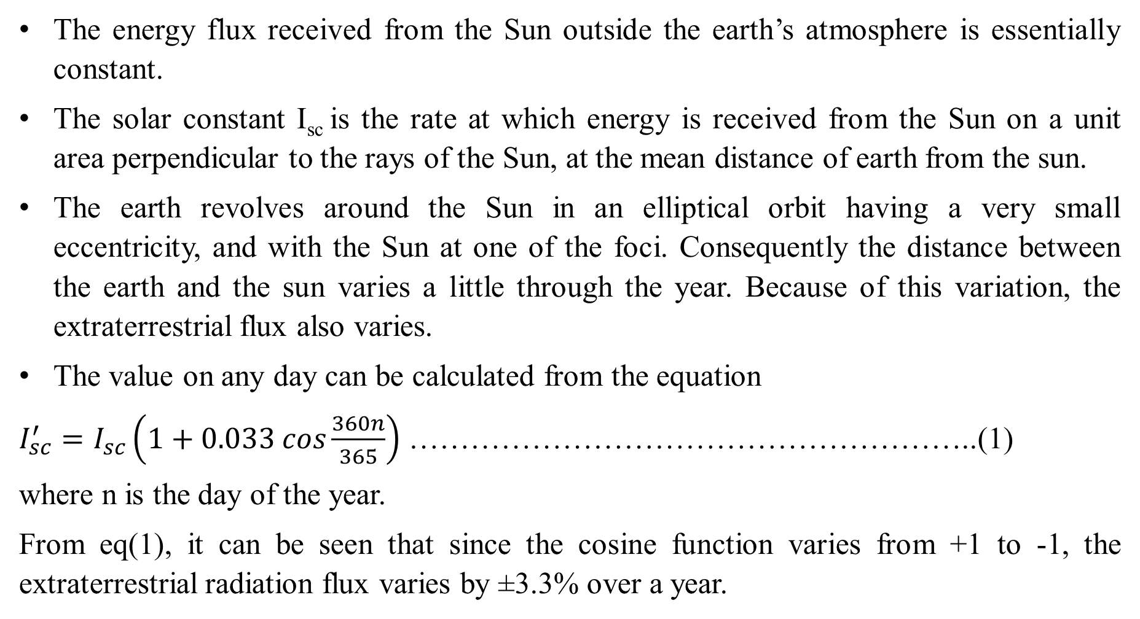
The energy flux received from the Sun outside the earth’s atmosphere is essentially constant.
The solar constant I_{sc} is the rate at which energy is received from the Sun on a unit area perpendicular to the rays of the Sun, at the mean distance of earth from the sun.
The earth revolves around the Sun in an elliptical orbit having a very small eccentricity, and with the Sun at one of the foci. Consequently the distance between the earth and the sun varies a little through the year. Because of this variation, the extraterrestrial flux also varies.
The value on any day can be calculated from the equation
$I_{sc}^{′}=I_{sc}\left(1+0.033 cos\frac{360n}{365}\right)$ ………………………………………………..(1)
where n is the day of the year.
From eq(1), it can be seen that since the cosine function varies from +1 to -1, the extraterrestrial radiation flux varies by ±3.3% over a year.

Slide 27
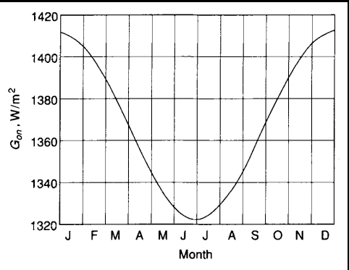
Variation of Extraterrestrial Radiation

Slide 28
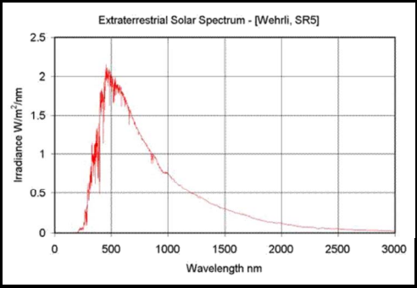
Solar radiation incident outside the earth atmosphere is called extraterrestrial radiation. Spectral distribution of extraterrestrial solar radiation is shown in figure1.
Fig1: Spectral distribution of extraterrestrial solar radiation
It will be seen that the spectral value first increases sharply with wavelength, passes through a maximum value at a wavelength of 498 nm and then decreases asymptotically to zero.

Slide 29
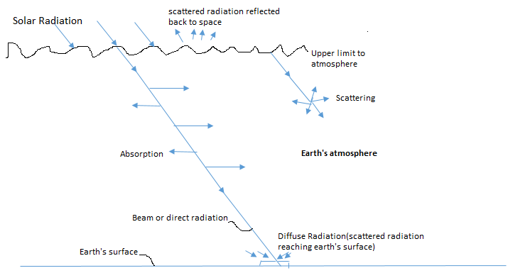
Solar Radiation at the Earth’s surface
Solar radiation is received at the earth’s surface in an attenuated form because it is subjected to the mechanisms of absorption and scattering as it passes through the earth’s atmosphere (fig2).
Fig 2: schematic representation of (i) mechanisms of absorption and scattering
(ii) Beam and diffuse radiation received at earth surface

Slide 30
Absorption occurs mainly due to the presence of ozone and water vapour in the atmosphere and due to other gases (like CO₂ , NO₂ , CO, O₂ and CH₄ ). It results in an increase in the internal energy of atmosphere.
Scattering occurs due to all gaseous molecules as well as particulate matter in the atmosphere. The scattered radiation is redistributed in all directions, some going back into space and some reaching earth surface.
Maximum radiation is received on the earth’s surface under the conditions of a cloudless sky.
Solar radiation received at earth’s surface without change of direction, i.e. in line with the Sun is called beam or direct radiation.
The radiation received at earth’s surface from all parts of the sky’s hemisphere is called diffuse radiation.
The sum of the beam and diffuse radiation is referred to as total or global radiation.

Slide 31
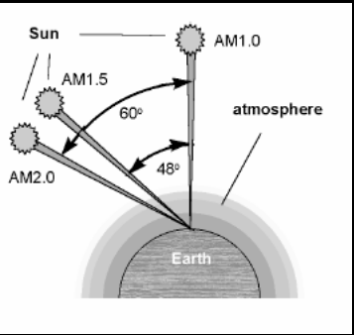
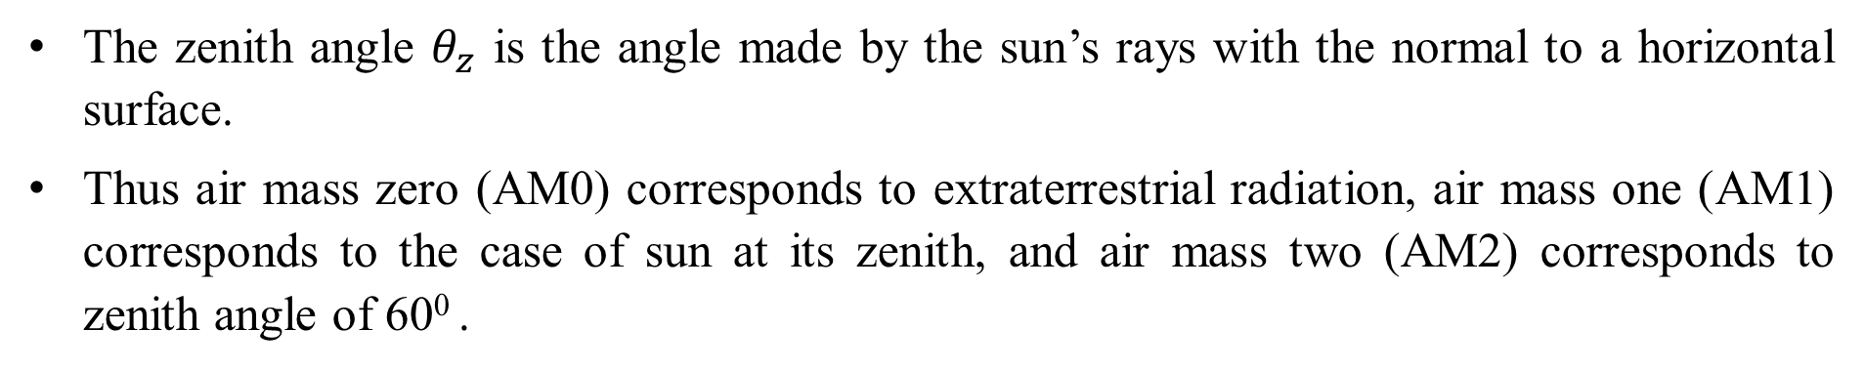
The air mass (AM) is used as a measure of the distance travelled by beam radiation through the atmosphere before it reaches a location on the earth’s surface.
It is defined as the ratio of the mass of atmosphere through which the beam radiation passes to the mass it would pass through if the sun is directly overhead (i.e.at its zenith).
The zenith angle $θ_{z}$ is the angle made by the sun’s rays with the normal to a horizontal surface.
Thus air mass zero (AM0) corresponds to extraterrestrial radiation, air mass one (AM1) corresponds to the case of sun at its zenith, and air mass two (AM2) corresponds to zenith angle of 60⁰ .

Slide 32
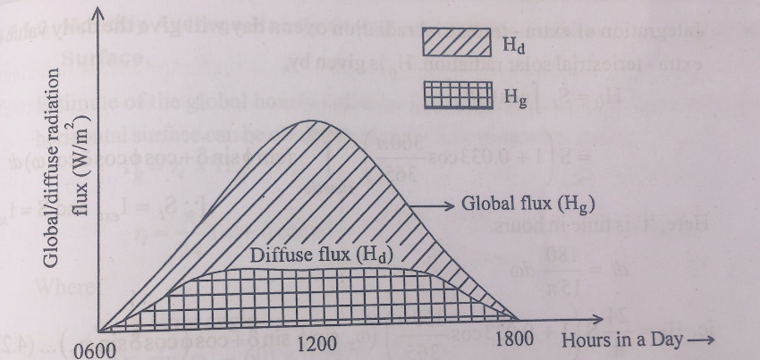
Solar Radiation Data
Most radiation data is measured for horizontal surfaces. A typical daily record of the global and diffuse radiation flux measured on a clear day is shown in figure
Fig: Record of global and diffuse radiation flux measured on a clear day

Slide 33
Solar radiation flux is sometimes reported in Langley per hour or per day (1 Langley = 1 cal/m² = 1.163X10⁻² kWh/m²). The unit ‘Langley’ has been adopted in honour of Samuel Langley who made the first measurement of the spectral distribution of the Sun.
A solar designer is primarily interested in average values for a location. A general idea of the availability of solar radiation over different regions can be obtained by constructing solar radiation maps.

Slide 34
Solar Radiation Geometry
Solar radiation geometry is the determining factor of heat gain, Shading and the potential of day light penetration.
Direction of beam radiation is useful in establishing geometric relationship between a plane and incoming beam solar radiation.
Direction of beam radiation can be described in terms of several angles. Angles useful in solar radiation analysis:
Latitude angle (ф), Declination angle (δ), Hour angle

Slide 35
Direction of Beam Radiation:
The geometric relationships between a plane of any particular orientation relative to the earth at any time and the incoming beam solar radiation can be described in terms of several angles (Latitude(φ), Declination(δ), Slope(β), Surface azimuth angle(γ), Hour angle(ω), Angle of incidence(θ), Zenith angle(θz), Solar altitude angle (αs) and solar azimuth angle (γs)).

Slide 36
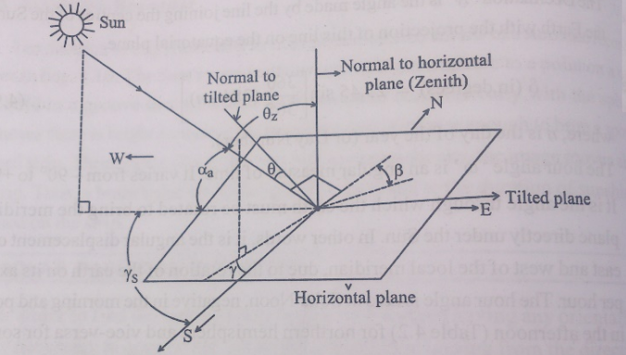

Slide 37
The latitude φ of a location is the angle made by the radial line joining the location to the centre of the earth with the projection of line on the equatorial plane. The latitude is measured as positive for the northern hemi sphere. It can vary from -90⁰ to +90⁰ .
The slope β is the angle made by the plane surface with the horizontal. It can vary from 0⁰ to 180⁰ .
The surface azimuth angle γ is the angle made in the horizontal plane between the horizontal line due south and projection of the normal to the surface on the horizontal line. It can vary from -180⁰ to +180⁰ . The angle is positive if the normal is east of south and negative if west of south.

Slide 38
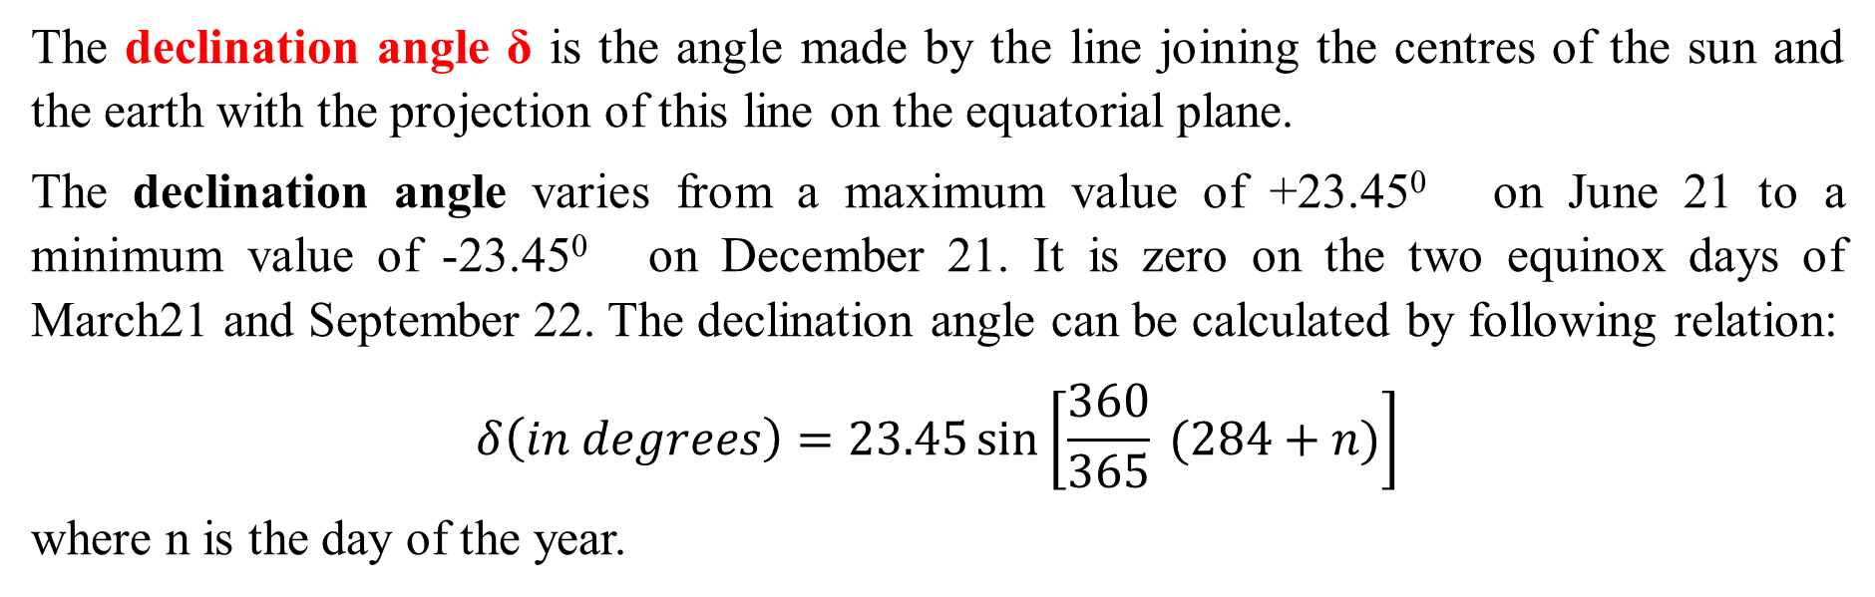
The declination angle δ is the angle made by the line joining the centres of the sun and the earth with the projection of this line on the equatorial plane.
The declination angle varies from a maximum value of +23.45⁰ on June 21 to a minimum value of -23.45⁰ on December 21. It is zero on the two equinox days of March21 and September 22. The declination angle can be calculated by following relation:
$$δ\left(in degrees\right)=23.45\sin\left[\frac{360}{365} (284+n)\right]$$
where n is the day of the year.

Slide 39
The hour angle ω is an angular measure of time and is equivalent to 15⁰ per hour. It also varies from -180⁰ to +180⁰ . We adopt the convention of measuring it from noon based on local apparent time, being positive in the morning and negative in the afternoon.

Slide 40
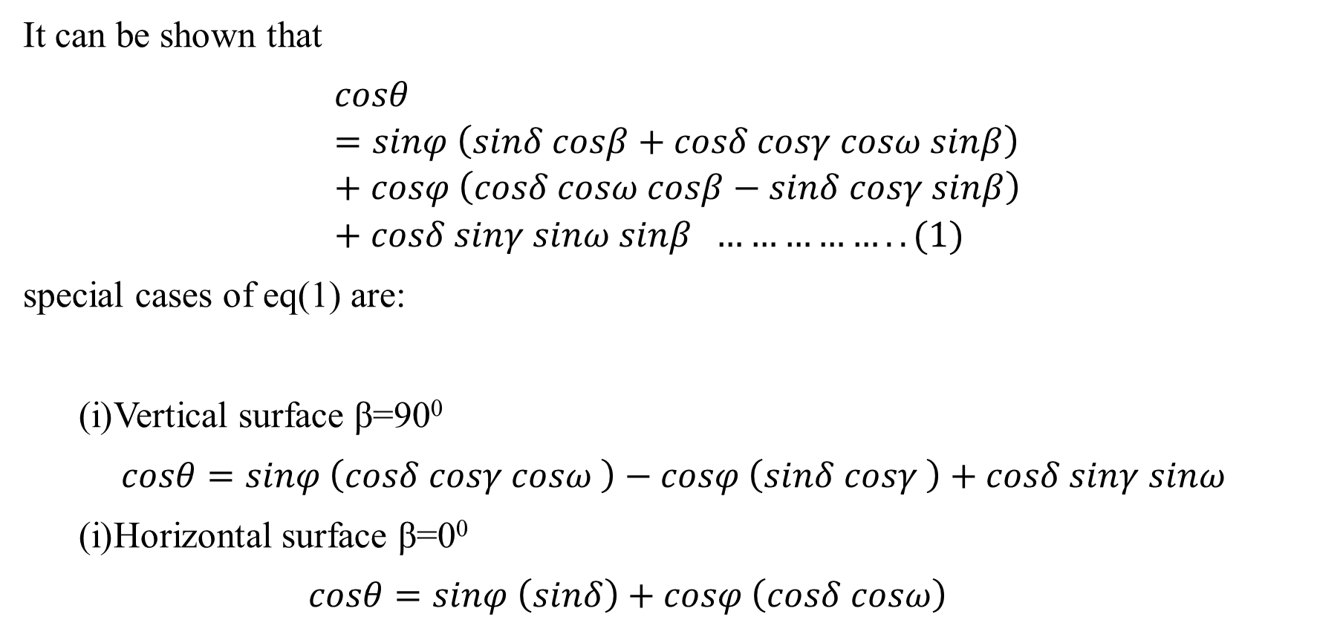
It can be shown that
$$cosθ=sinφ \left(sinδ cosβ+cosδ cosγ cosω sinβ\right)+cosφ \left(cosδ cosω cosβ−sinδ cosγ sinβ\right)+cosδ sinγ sinω sinβ ……………..(1)$$
special cases of eq(1) are:
Vertical surface β=90⁰
$$cosθ=sinφ \left(cosδ cosγ cosω \right)−cosφ \left(sinδ cosγ \right)+cosδ sinγ sinω$$
Horizontal surface β=0⁰
$$cosθ=sinφ \left(sinδ\right)+cosφ \left(cosδ cosω\right)$$

Slide 41
Local Apparent Time: The time used for calculating the hour angle ω is the local apparent time.
Local Apparent Time= standard time±4 (standard time longitude- longitude of location) + (Equation of time correction)
The negative sign is applicable for eastern hemisphere, positive sign is applicable for western hemisphere.
The equation of time correction (in minutes) can be calculated from the following empirical relation:
E= 229.18(0.000075+0.001868 cosB-0.032077 sin B – 0.014615 cos2B- 0.04089 sin 2B)

Slide 42
EX1:Determine the local apparent time (LAT) corresponding to 1430 h (IST) at Mumbai (19⁰ 07’N, 72⁰ 51’E) on July1, India, standard time is based on 82.50⁰ E.

Slide 43
Sol:
Local Apparent Time= 1430- 4(82.5-72.85) minutes + (-3.5 minutes) =1348 h

Slide 44
Solar Radiation on Tilted surfaces
Measuring instruments give the values of solar radiation falling on a horizontal surface.
However, most solar equipment (e.g., flat-plate collectors), for absorbing radiation, are tilted at an angle to the horizontal. It therefore becomes necessary to calculate the flux which falls on a tilted surface.
This flux is sum of the beam and diffuse radiation falling directly on the surface and the radiation reflected onto the surface from the surroundings.

Slide 45
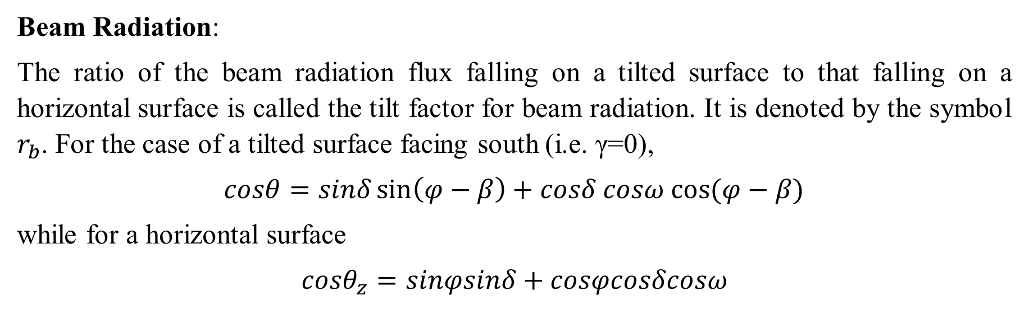
The amount of solar radiation on a surface on earth at any position at a particular time depends on the orientation and inclination of a surface.
An inclined surface takes direct (G_{Bt}), diffuse (G_{Dt}) and ground reflected (G_{Gt}) radiation given by: Gt = G_{Bt} + G_{Dt} +G_{Gt}
Beam Radiation:
The ratio of the beam radiation flux falling on a tilted surface to that falling on a horizontal surface is called the tilt factor for beam radiation. It is denoted by the symbol $r_{b}$. For the case of a tilted surface facing south (i.e. γ=0),
$$cosθ=sinδ\sin\left(φ−β\right)+cosδ cosω cos⁡(φ−β)$$
while for a horizontal surface
$$cosθ_{z}=sinφsinδ+cosφcosδcosω$$

Slide 46
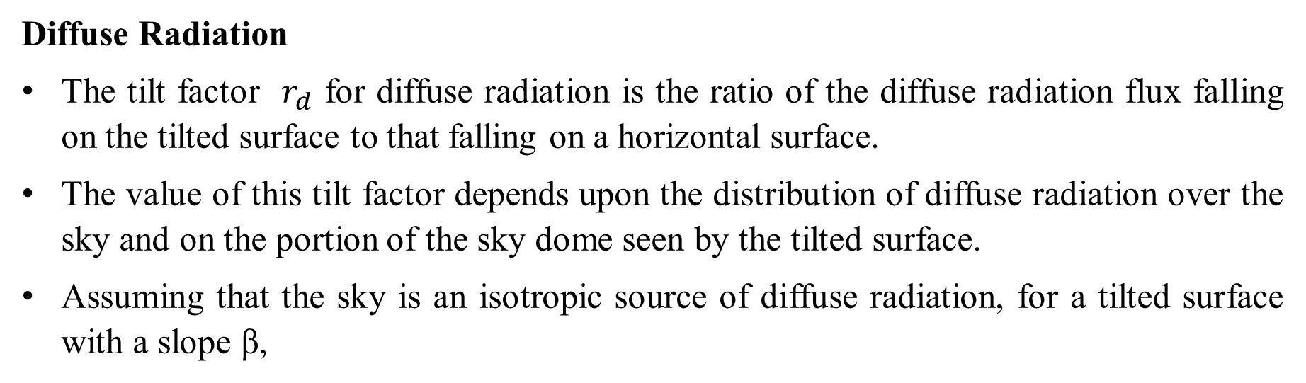
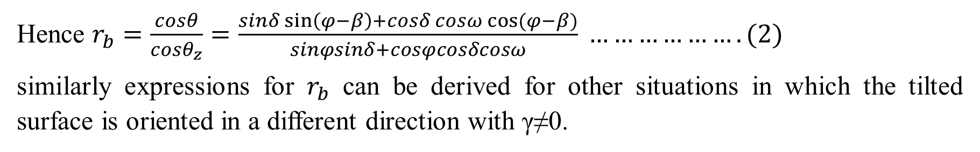
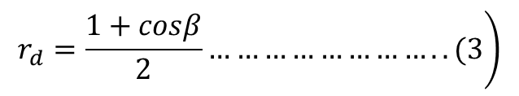
Hence $r_{b}=\frac{cosθ}{cosθ_{z}}=\frac{sinδ\sin\left(φ−β\right)+cosδ cosω cos⁡(φ−β)}{sinφsinδ+cosφcosδcosω} ……………….(2)$
similarly expressions for $r_{b}$ can be derived for other situations in which the tilted surface is oriented in a different direction with γ≠0.
Diffuse Radiation
The tilt factor $r_{d}$ for diffuse radiation is the ratio of the diffuse radiation flux falling on the tilted surface to that falling on a horizontal surface.
The value of this tilt factor depends upon the distribution of diffuse radiation over the sky and on the portion of the sky dome seen by the tilted surface.
Assuming that the sky is an isotropic source of diffuse radiation, for a tilted surface with a slope β,
$$\left.r_{d}=\frac{1+cosβ}{2}……………………..(3\right)$$

Slide 47
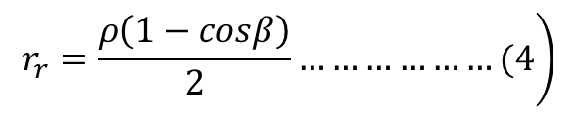
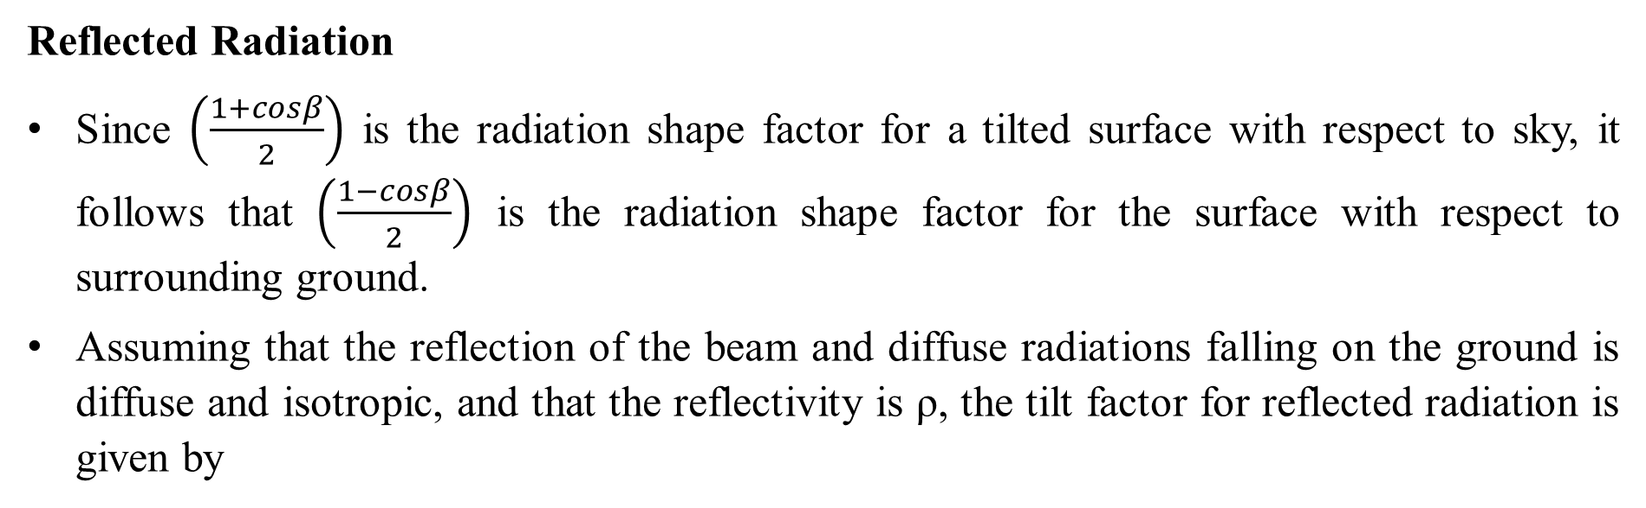
Reflected Radiation
Since $\left(\frac{1+cosβ}{2}\right)$ is the radiation shape factor for a tilted surface with respect to sky, it follows that $\left(\frac{1−cosβ}{2}\right)$ is the radiation shape factor for the surface with respect to surrounding ground.
Assuming that the reflection of the beam and diffuse radiations falling on the ground is diffuse and isotropic, and that the reflectivity is ρ, the tilt factor for reflected radiation is given by
$$\left.r_{r}=\frac{ρ\left(1−cosβ\right)}{2}………………(4\right)$$

Slide 48
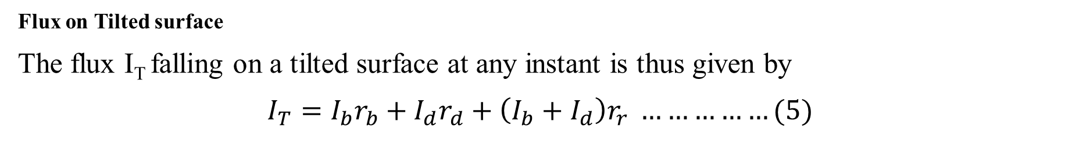
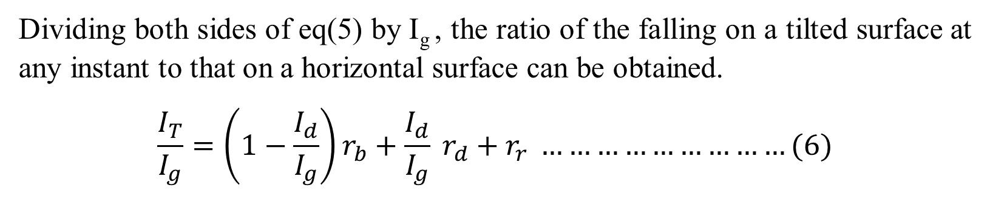
Flux on Tilted surface
The flux I_{T} falling on a tilted surface at any instant is thus given by
$$I_{T}=I_{b}r_{b}+I_{d}r_{d}+\left(I_{b}+I_{d}\right)r_{r} ……………(5)$$
where the values of $r_{b}$,$r_{d}$ and $r_{r}$ are given as per eq (2), (3) and (4).
Dividing both sides of eq(5) by I_{g} , the ratio of the falling on a tilted surface at any instant to that on a horizontal surface can be obtained.
$$\frac{I_{T}}{I_{g}}=\left(1−\frac{I_{d}}{I_{g}}\right)r_{b}+\frac{I_{d}}{I_{g}} r_{d}+r_{r} ………………………(6)$$

Slide 49
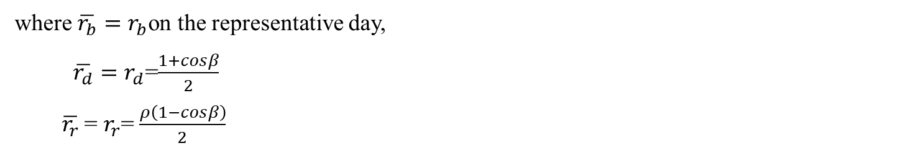
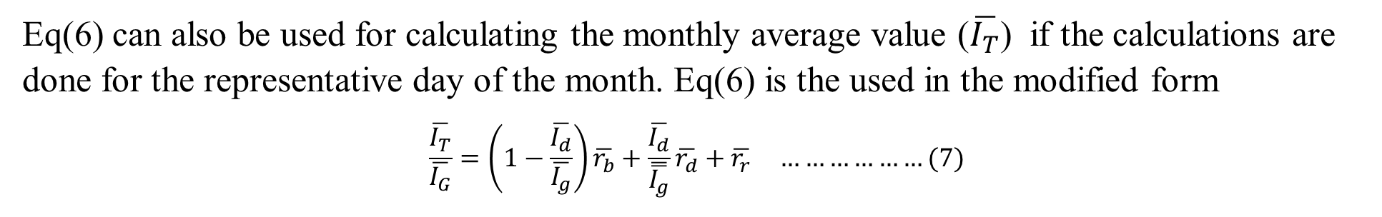
Eq(6) can also be used for calculating the monthly average value ($\overline{I_{T}}$) if the calculations are done for the representative day of the month. Eq(6) is the used in the modified form
$$\frac{\overline{I_{T}}}{\overline{I_{G}}}=\left(1−\frac{\overline{I_{d}}}{\overline{I_{g}}}\right)\overline{r_{b}}+\frac{\overline{I_{d}}}{\overset{̿}{I_{g}}}\overline{r_{d}}+\overline{r_{r}} ………………(7)$$
where $\overline{r_{b}}=r_{b}$on the representative day,
$\overline{r_{d}}=r_{d}$=$\frac{1+cosβ}{2}$
$\overline{r_{r}}$ = $r_{r}$= $\frac{ρ\left(1−cosβ\right)}{2}$

Slide 50
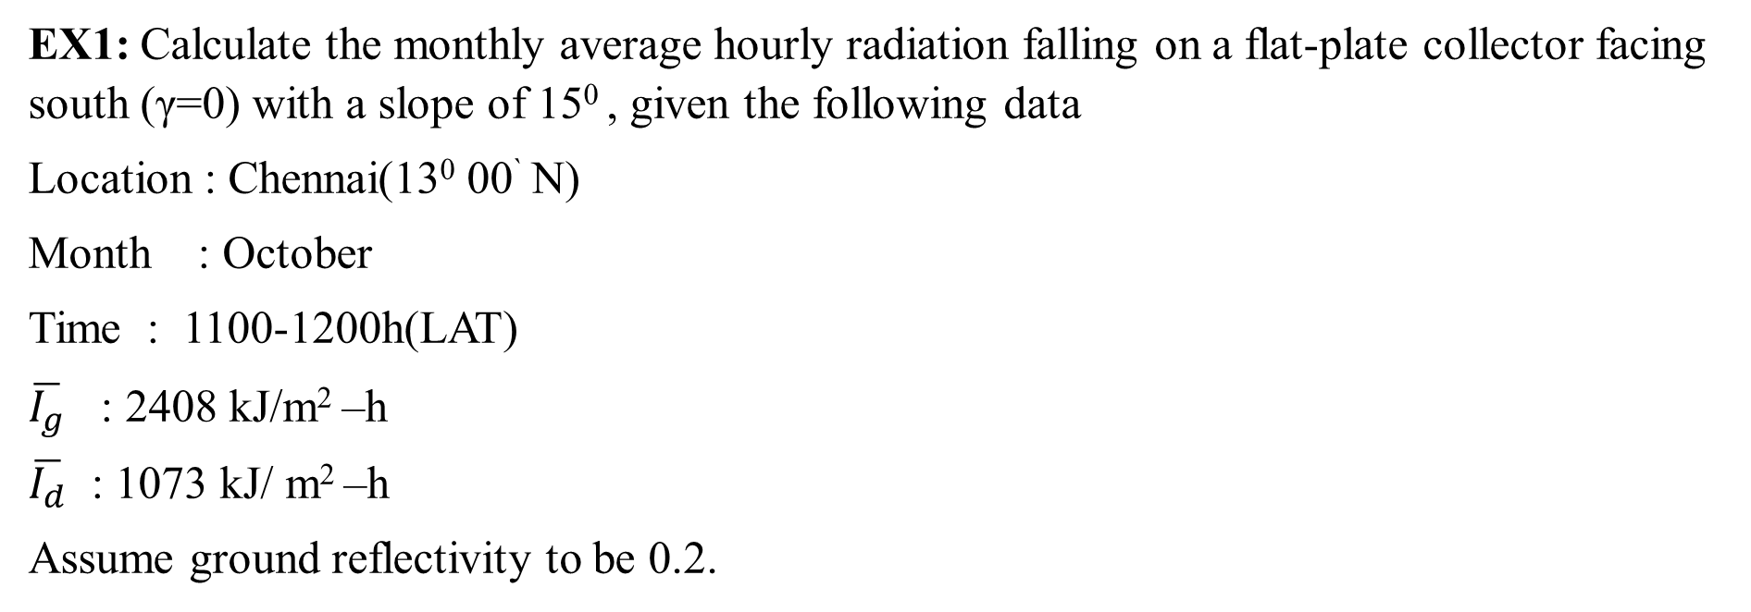
EX1: Calculate the monthly average hourly radiation falling on a flat-plate collector facing south (γ=0) with a slope of 15⁰ , given the following data
Location : Chennai(13⁰ 00` N)
Month : October
Time : 1100-1200h(LAT)
$\overline{I_{g}}$ : 2408 kJ/m² –h
$\overline{I_{d}}$ : 1073 kJ/ m² –h
Assume ground reflectivity to be 0.2.

Slide 51
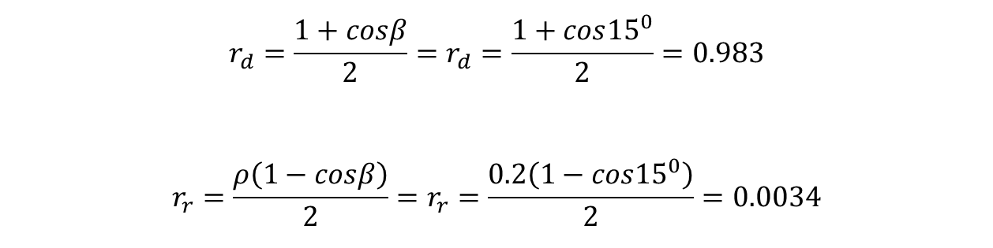
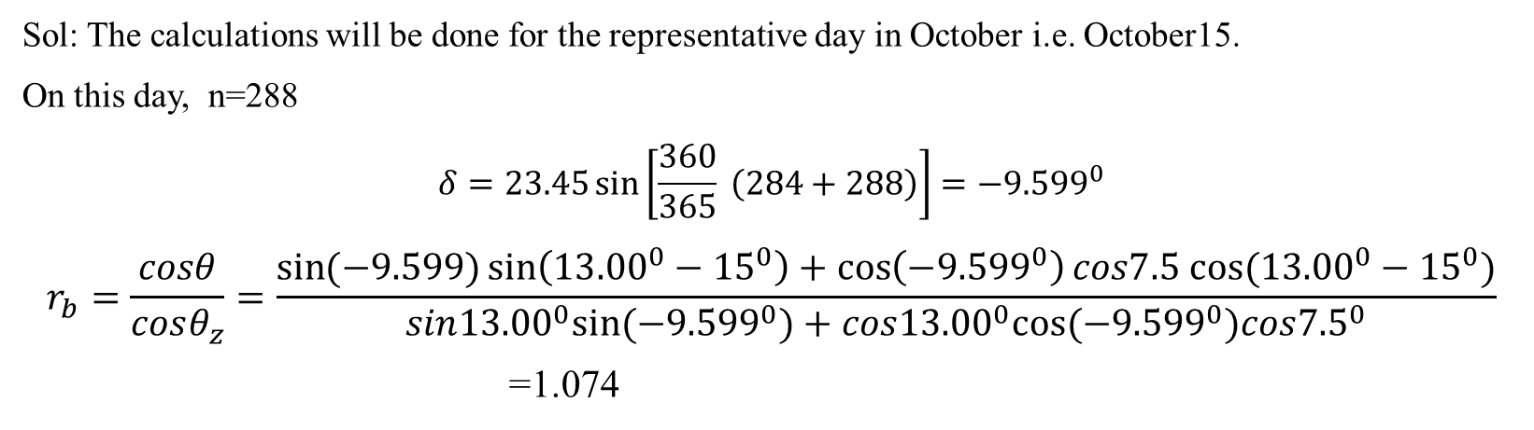
Sol: The calculations will be done for the representative day in October i.e. October15.
On this day, n=288
$$δ=23.45\sin\left[\frac{360}{365} \left(284+288\right)\right]=−{9.599}^{0}$$
$$r_{b}=\frac{cosθ}{cosθ_{z}}=\frac{\sin{(−9.599)}\sin\left({13.00}^{0}−{15}^{0}\right)+\cos\left(−{9.599}^{0}\right)cos7.5 cos⁡({13.00}^{0}−{15}^{0})}{sin{13.00}^{0}sin⁡(−{9.599}^{0})+cos{13.00}^{0}cos⁡(−{9.599}^{0})cos{7.5}^{0}}$$
=1.074
$$r_{d}=\frac{1+cosβ}{2}=r_{d}=\frac{1+cos{15}^{0}}{2}=0.983$$
$$r_{r}=\frac{ρ\left(1−cosβ\right)}{2}=r_{r}=\frac{0.2\left(1−cos{15}^{0}\right)}{2}=0.0034$$

Slide 52

$$\frac{\overline{I_{T}}}{\overline{I_{G}}}=\left(1−\frac{1073}{2408}\right)X1.074+\frac{1073}{2408}X0.9830+0.0034=1.0369$$
$$\overline{I_{T}}=1.369∗2408=2497 kJ/ m2 –h$$

